Slide 1
CSCW Technologies over time

Slide 2
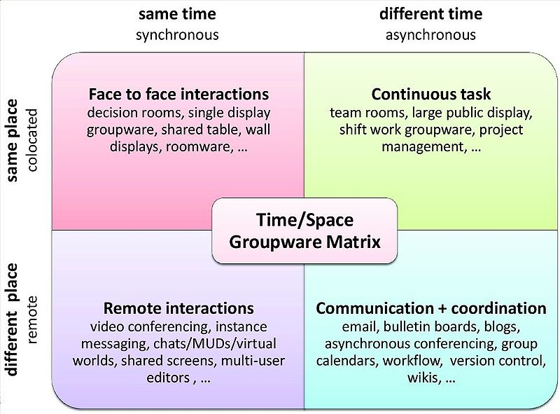

Slide 3
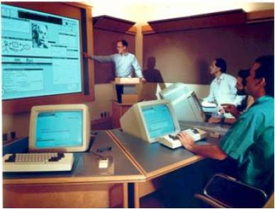
Group Decision Rooms
Embeds decision making process
dedicated computer-based conference facility
real time large group support (5-50)
typically facilitated
may embed a structured meeting process
Typical function
explore unstructured problems
brainstorm ideas
organize/prioritize results
voting…
good for brainstorming
http://pages.cpsc.ucalgary.ca/~saul/781
The COLAB meeting room, Xerox PARC http://www2.parc.com/istl/members/stefik/colab.htm

Slide 4
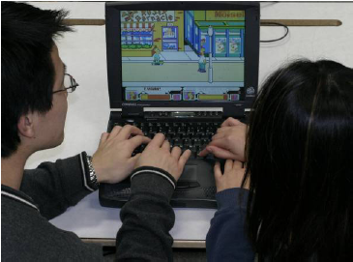
Single Display Groupware
Multiple people using a single display
multiple input devices
simultaneous input
new interaction widgets
technical issues (O/S)
conflict with conventional applications
supporting social conventions of simultaneous work
mice vs. direct touch…
Edward Tse http://grouplab.cpsc.ucalgary.ca/papers/2004/04-SDGToolkit-MScThesis/SDGToolkit-MSc.pdf
http://pages.cpsc.ucalgary.ca/~saul/781
Notes:
These have not taken off!

Slide 5
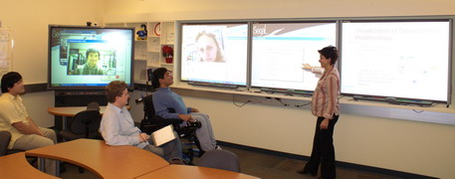
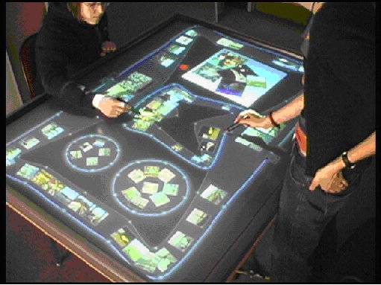
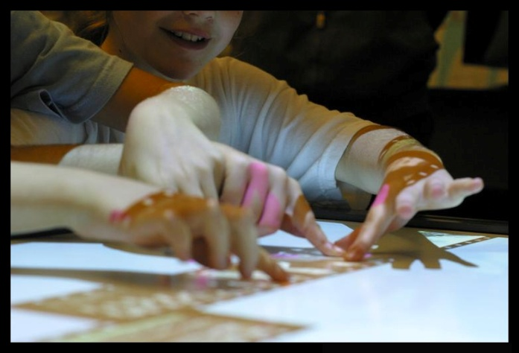
Shared Table / Wall Displays
device characteristics
social affordances of tables/wall
SEGAL Lab, UVic
http://pages.cpsc.ucalgary.ca/~saul/781

Slide 6
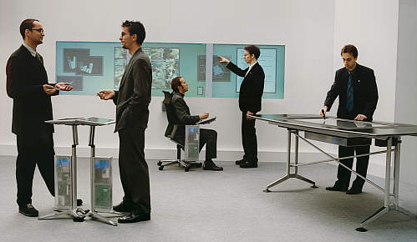
Roomware
Computer-augmented room elements
integrated desk/wall displays for collaboration
Inter-operation between devices
http://pages.cpsc.ucalgary.ca/~saul/781
From the GMD Darmstadt web site on I-Land
Notes:
Tangible computing – again… not so prevalent! Still coming?

Slide 8
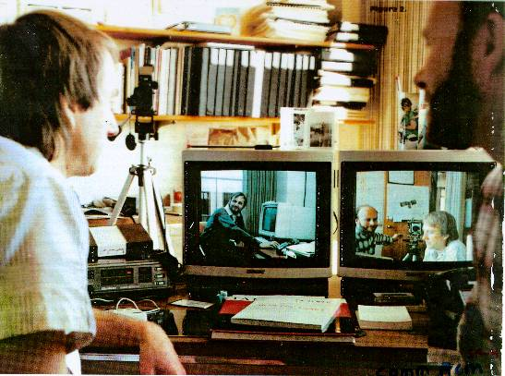
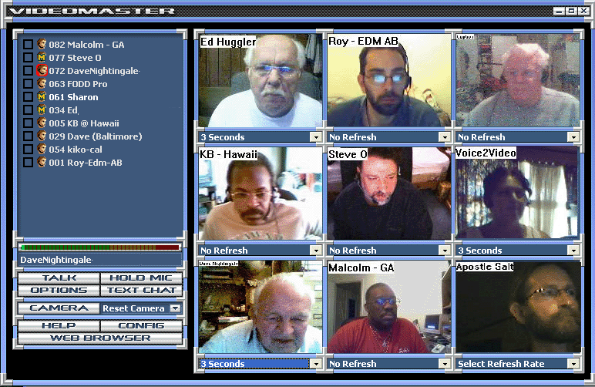
Video / Audio conferencing
Desktop conferencing
bandwidth/latency issues
what is the value of talking heads?
Xerox Parc video link
VoiceToVideo, http://www.voicetovideo.com/images/video_lge.gif
http://pages.cpsc.ucalgary.ca/~saul/781

Slide 9

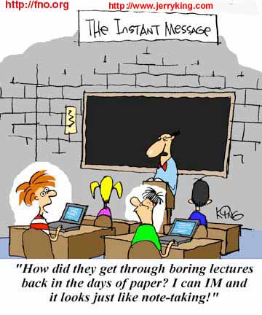
Instant messengers
Casual interaction
awareness to light-weight conversations
Killer app
evolving social norms
defining communities
http://pages.cpsc.ucalgary.ca/~saul/781

Slide 10
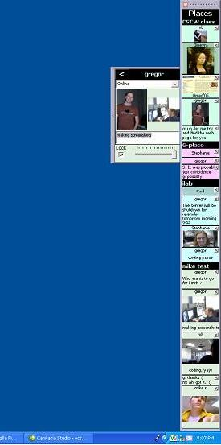
Rich Instant Messaging
Can do much more than text
How does one handle complexity?
How does one handle interruption?
Community Bar, by Gregor Mcewan, U Calgary
http://pages.cpsc.ucalgary.ca/~saul/781
Notes:
These are still challenges!

Slide 11
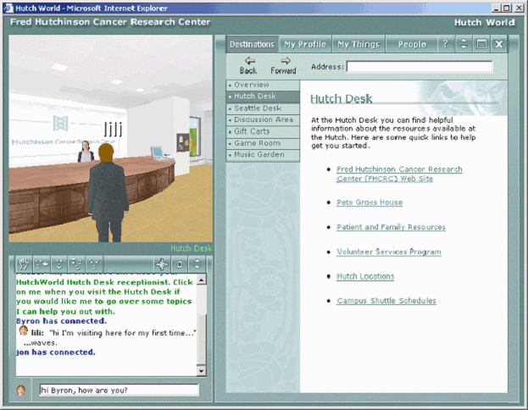
Chat rooms/MUDS/Virtual worlds
Space for meeting and interacting with people
from text to 3d spaces
can move between ‘rooms’ and/or around space
seeing/manipulating artifacts
self-representation (avatars)
community of strangers
shared purpose…
http://pages.cpsc.ucalgary.ca/~saul/781
Fred Hutchinson Cancer Research Center: Social Support for Cancer Patients

Slide 12
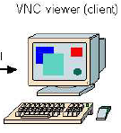
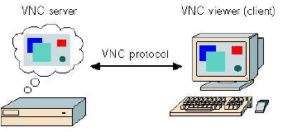
Shared Screens/Windows
Share unaltered single user applications
technical concerns
how regions are captured/transmitted
architectural limitations
controlling input
access control…
social limitations
turntaking
control
privacy
Richardson, T., Stafford-Fraser, Q., Wood, K. and Hopper, A.
Virtual Network Computing. IEEE Internet Computing. Vol. 2, No. 1. p33-39. January/February, 1998.
http://pages.cpsc.ucalgary.ca/~saul/781

Slide 13
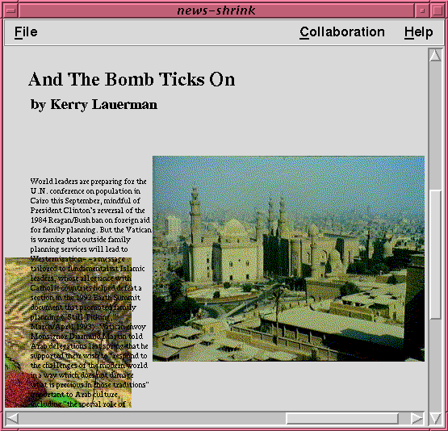
Multi-user editors
True groupware for visual artifacts
structured documents (e.g., text paper)
visual workspace (2d graphics)
awareness
conflicting actions
tight vs. loose coupling
relaxed WYSIWIS
Google docs!
http://pages.cpsc.ucalgary.ca/~saul/781

Slide 14
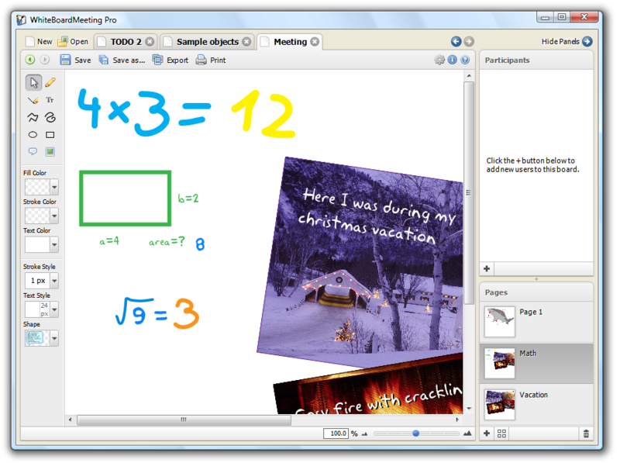
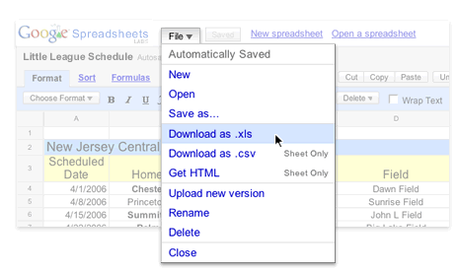
Collaborative editors cont.
http://whiteboardmeeting.com
White board editor for Skype
Google docs/spreadsheet,…
See http://en.wikipedia.org/wiki/Collaborative_editor
Notes:
Which kind of users more likely to use these?

Slide 16
Email
Many styles
vanilla email
threaded mail
intelligent mail (routing / sorting)
structured mail (by speech acts)
multimedia mail
distribution lists / elist servers
Social
managing complexity and overloads
spam
archiving
http://pages.cpsc.ucalgary.ca/~saul/781

Slide 17
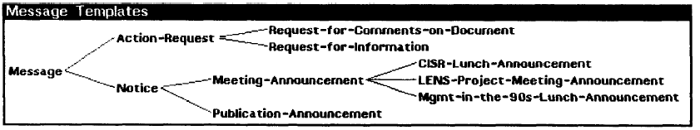
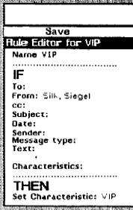
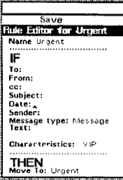
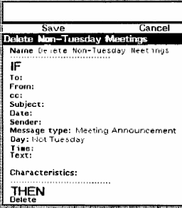
Email – Information Lens
Structured email
messages as inherited object types
Rules
http://pages.cpsc.ucalgary.ca/~saul/781

Slide 18
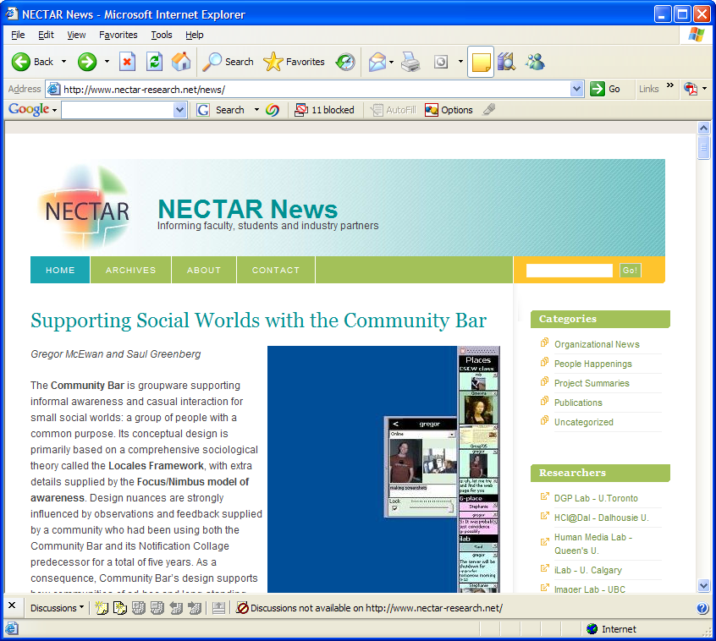
Communal Messaging
Many types
bulletin boards
computer conferencing
discussion groups
blogs
e.g., Usenet
http://pages.cpsc.ucalgary.ca/~saul/781

Slide 19
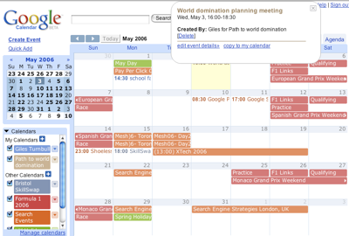
Group Calendars
common calendar
meeting scheduling
resource use
privacy
who keeps things up to date?
how do you stop people scheduling your meetings?
http://pages.cpsc.ucalgary.ca/~saul/781

Slide 20
Workflow
“Integration and harmonious adjustment of individual work efforts toward the accomplishment of a larger goal” – B. Singh
Codified procedures and processes
PeopleSoft
forms management and routing
coordination theory (speech acts)
Notifications triggering user actions
triggering automated actions
standard operations
exceptions management
http://pages.cpsc.ucalgary.ca/~saul/781

Slide 21
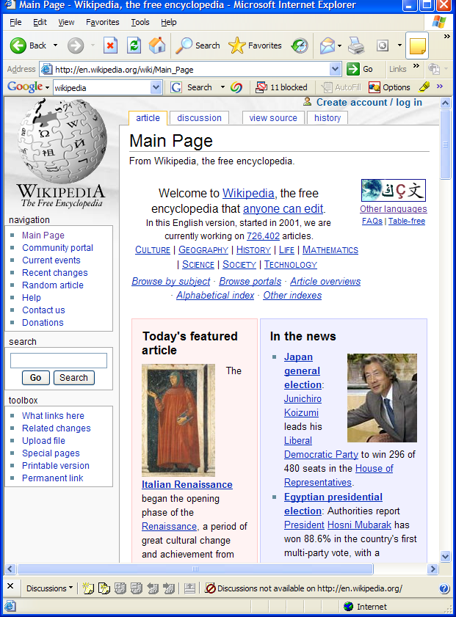
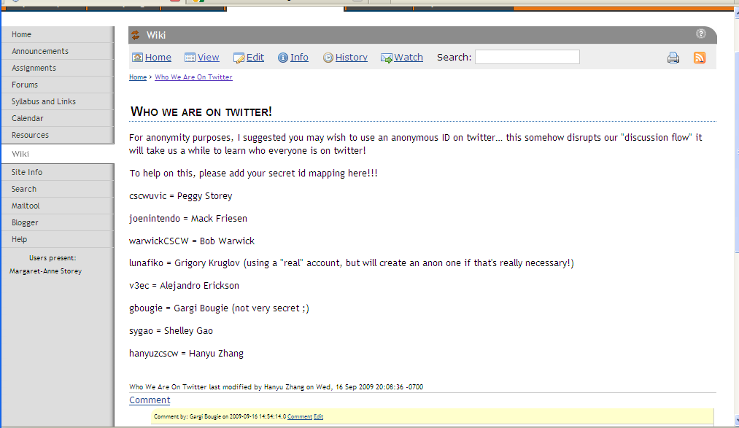
Wikis
Group-viewable / editable web site
community of strangers to community of collaborators
culture of what is allowed vs. hard-coded access control
http://pages.cpsc.ucalgary.ca/~saul/781

Slide 23
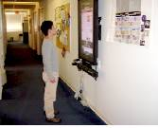
Community Bulletin Boards
Post information from various sources to public place
who posts?
how to personalize?
relevance?
from Multimedia Fliers, Churchill, Nelson, Denoue, Communites and Technoligies 2003
http://pages.cpsc.ucalgary.ca/~saul/781

Slide 24
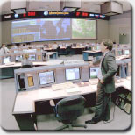
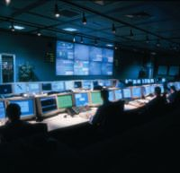
Control Rooms
Information that goes across shifts
NASA Mission Control Center http://spaceflight.nasa.gov/shuttle/reference/mcc/
Reuters, http://www.electrosonic.com/command_and_control.shtm
http://pages.cpsc.ucalgary.ca/~saul/781
Notes:
Hospitals… you would think it is solved… but it isn’t.

Slide 26
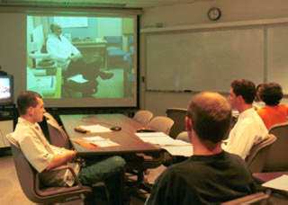
Connected meeting rooms
Meeting / classroom
Video / audio links
http://pages.cpsc.ucalgary.ca/~saul/781
Veterinary Report Vol 26, 1 Winter 2002 http://www.cvm.uiuc.edu/vetreport/winter2002/technology.html

Slide 27
Anytime, any place “groupware”
same time
different times
same
place
different places
http://pages.cpsc.ucalgary.ca/~saul/781
Notes:
What would this look like? Do we have anything like this.

Slide 28
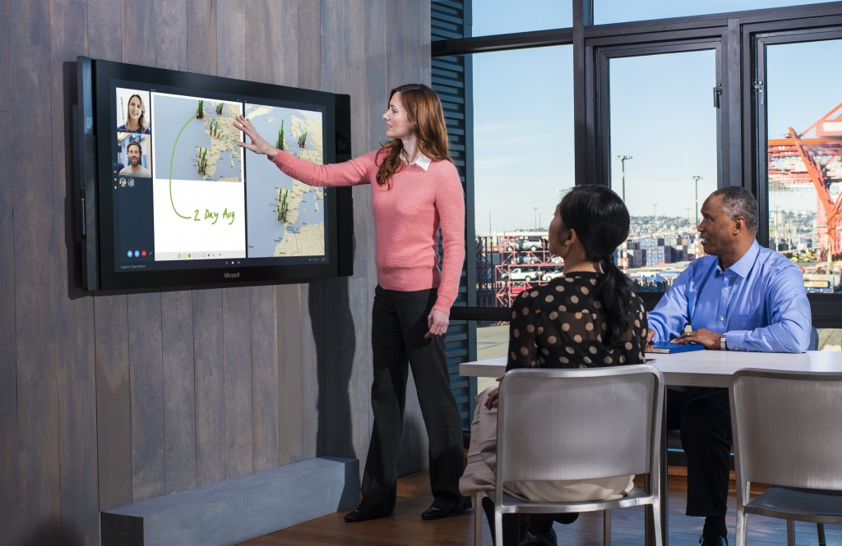
Surface Hub

Slide 29
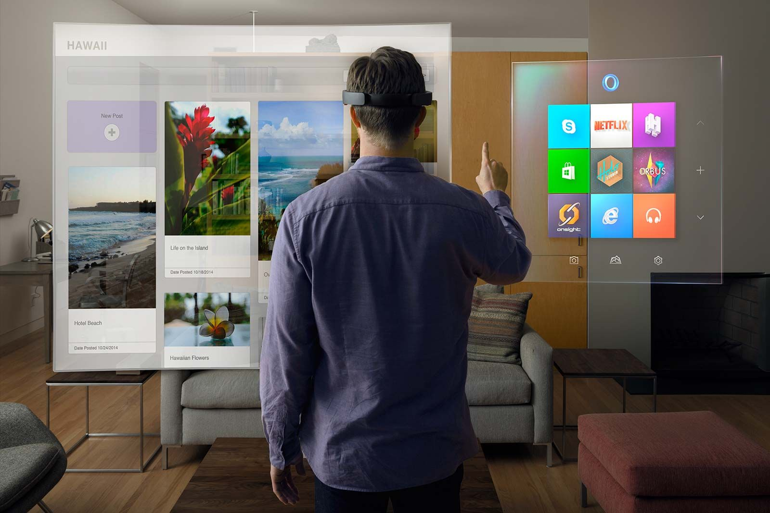
HoloLens

Slide 30
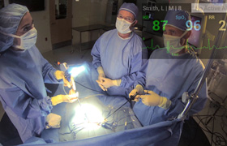
Google Glass

Slide 31
CSCW Tool Design

Slide 32
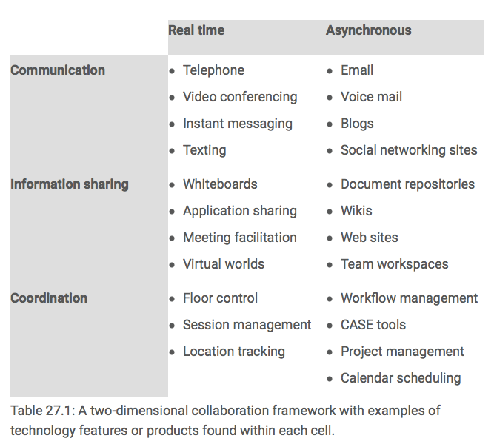
Notes:
From: https://www.interaction-design.org/encyclopedia/cscw_computer_supported_cooperative_work.html

Slide 33
Design and Adoption Challenges
http://www.interaction-design.org/encyclopedia/cscw_computer_supported_cooperative_work.html
Notes:
Adoption may be affected if too much work is needed without a compensating benefit
Intuition of managers may not appreciate how technology will be received by other group members
3. Tragedy of the commons – a technology may cease to be useful if too many people embrace it E.g. too much email.
Prisoner’s dilemma – if everyone looks to their own best interest, free riding on coat tails of others, then outcomes deteriorate and use may collapse altogether.
4. If a new channel disrupts information exchange, it will lead to uncertainty about where to find information and may change who knows what thus changing authority potentially.
Exceptions are just often not handled – hard to handle – disrupt how workflow systems work! A good manager knows how to deal with exceptions to policy, software does not.
Should not be obtrusive and yet need to be accessible.
Mentioned this already – providing evidence something helps is a killer
Adoption has to be considered from the get go.

Slide 34
Opportunities?
Constant reinvention of technologies, less expensive to use, more accessible
From awareness to too much awareness
Immersive technologies? Interest has waxed and waned
Domains of education, medicine and software development are seeing rapid adoption of collaborative technologies – focus for study, but also need for new skills in those domains
How to deal with transparency?
http://www.interaction-design.org/encyclopedia/cscw_computer_supported_cooperative_work.html
Notes:
Internet, WWW led to ability to be able to know what distant collaborators are doing.
But now we know too much and worry what people know about you - privacy and disruption an issue since 1996

Slide 35
But…
We need to adapt the technology to the organization and vice versa (Bannon)
Even a small change can lead to significant changes… we need to study and understand those changes (can we predict them?)

